Slide 1
Real Time Network Intrusion Detection and Network Traffic Visualization
Keshav Chaurasia 072BEX423
Anuska Pant 072BEX405
Bibek Thapa Magar 072BEX409
Anil Dhakal 072BEX451

Slide 2
Objectives
1. To capture the packets flowing in the campus network.
2. To analyze the packets and detect security threats and attacks.
3. To alert the respective entity and admins .
4. To make visualization of traffic in the network.
5. To take measures to prevent the attacks in future.

Slide 3
Why IDS?
1. firewall only cannot block all malicious traffic
2. IDS can do deep packet inspection

Slide 4
Modules
Data set generation
Neural Network model creation, training and evaluation
Environment set up
Real time NIDS and alert notification system for detected attacks using trained model
Network Traffic visualization Dashboard for Network Admins

Slide 5
Data set generation
We captured network traffic for 5 days inside Boys hostel for the collection of normal traffic
We performed simulation of different attacks to collect threat traffic

Slide 6
Data set in depth
Normal Traffic – 60,169 flows
Attack/Threat Traffic
  Subnet Scan – 5448 flows
  Port scan – 227 flows
  Host scan – 85 flows
  ICMP Flooding – 3 flows
  SSH Brute force – 5415 flows
  DOS attempt – 5015 flows

Slide 7
Neural Network Model Creation
Load
training data
Preprocess
data
Encode
data
Neural
Network
Model
– Fully connected sequential
Neural Network
– 3 hidden layers
– Relu activation function
Neural
Network
training
– 30 epochs
Save model
for RT-NIDS
Neural
Network
evaluation
– Accuracy,, Precision, Recall
– ROC Curve and AOC Value

Slide 8
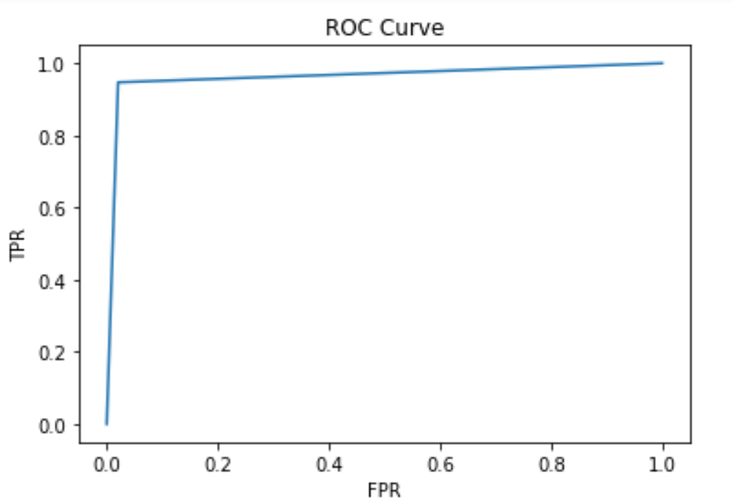
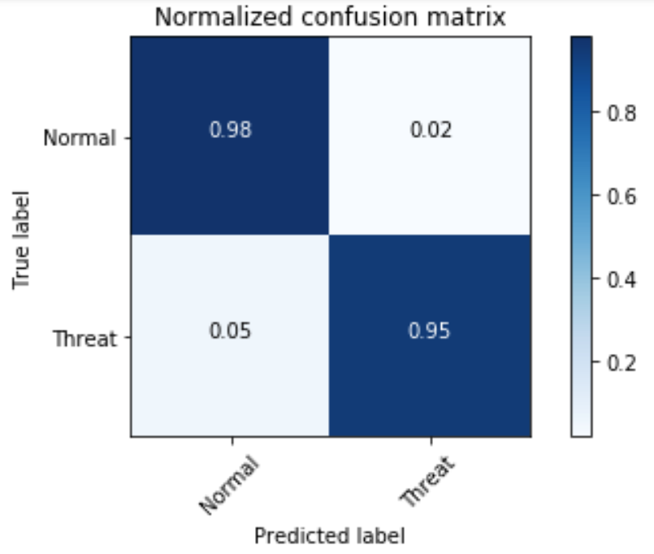
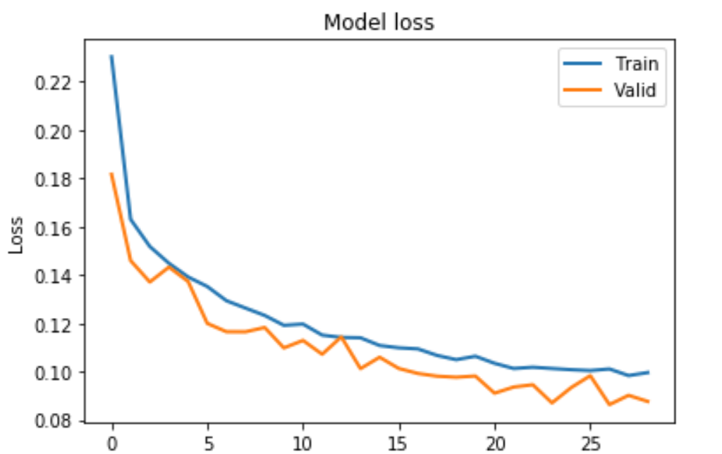
Evaluation
Accuracy: 0.968773
Precision: 0.958759
Recall: 0.947158
F1 score: 0.952923
AUC: 0.9634

Slide 9
Environment set up
Main Switch
Switch
Block A Switch
Gateway
Host 1
Host 2 3 4 5
Host 1
Host 2
Host 3
Host 4
Host 5
Traffic flow for the Environment
Network Diagram of block A campus hostel network

Slide 10
Real Time NIDS
Capture packets
at 1 minute interval
Convert pcap
to netflow records
Preprocess record
Evaluate each record
with trained model
Yes
Is
attack?
Report network Admin
Store the record in
database
No

Slide 11
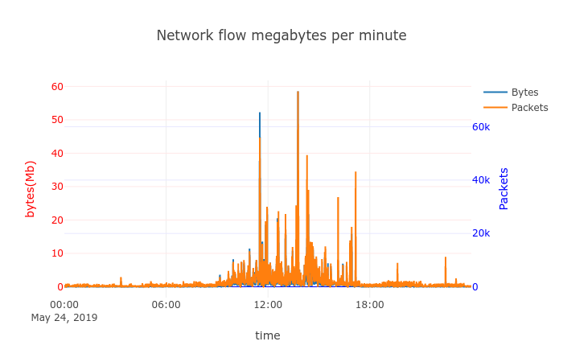
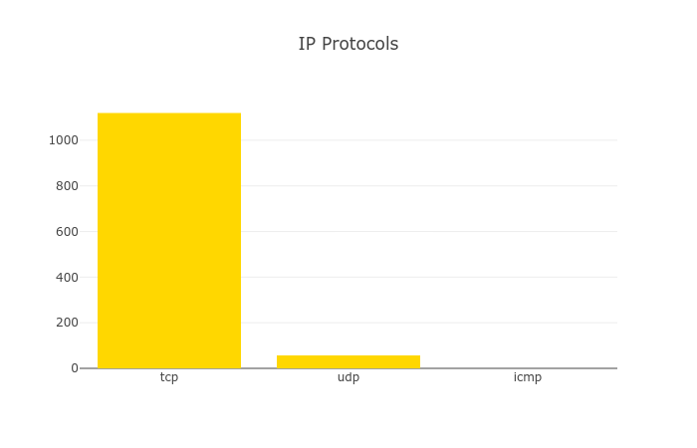
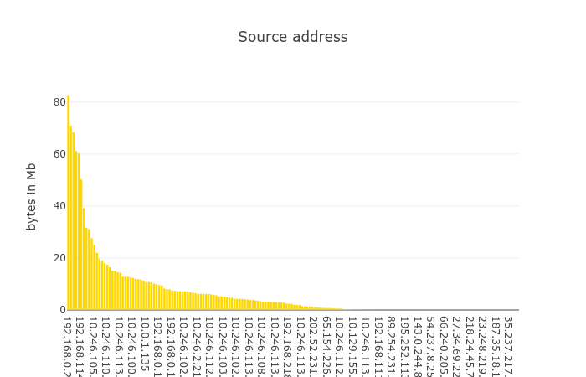
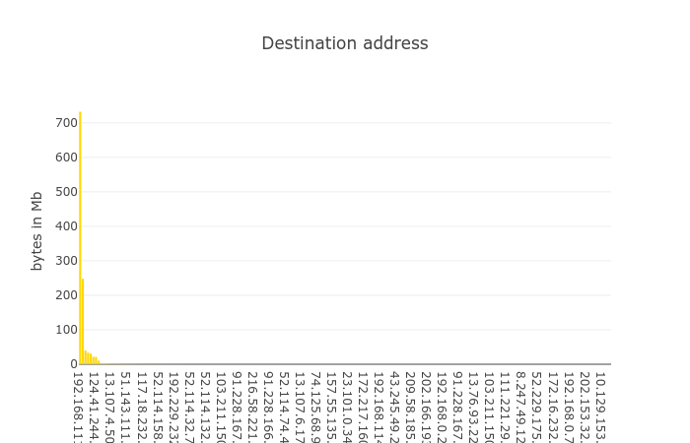
Network Traffic Visualization

Slide 12
Limitations
Detects only few attack types
False Positive attack alerts
Doesn’t do packet payload inspection

Slide 13
Works completed
Data set generation – 70%
Model Creation – 70%
Network Traffic Visualization – 40%

Slide 14
Works left
Real time NIDS system implementation
Creating a web portal for network admin

Slide 15
Thank you

